Slide 1

UEEN 3113 / 3413
Server Configuration and management

Slide 2
Samba
Allows us to share files with Windows, Linux, and Mac OS X machines using Server Message Block (SMB) protocol.
To install samba:
sudo apt install samba
To check the status of samba
sudo systemctl status smbd
Before we make changes to the configuration file, make a backup copy.
cp /etc/samba/smb.conf /etc/samba/smb.conf.ori

Slide 3
Samba
Lines start with ; or # are ignored.
A line that ends with \ is continued on the next line.
Each section except [global] defines a share resource.
Names are not case sensitive.
Notes:
Medium level example: mySQL605

Slide 4
Samba
Sections in smb.conf
[global]
workgroup = workgroup_name
server string = server_description
dns proxy= yes/no
interfaces = ip/netmask or interface_name
bind interfaces only = yes/no
log file = /var/log/samba/log.%m
map to guest = bad User
Notes:
Medium level example: mySQL605

Slide 5
Samba
[global]
the global section of configuration, which consist of settings that will impact Samba as a whole or default for undefined items in other sections.
server string: a description for the server.
workgroup: a namespace that describes a group of machines.
map to guest: treat unauthenticated users as guest users

Slide 6
Samba
Sections in smb.conf (printer sharing)
[printers]
comment = Any comment
browseable = no
path = /var/spool/samba
printable = yes
guest ok = no
read only = yes
create mask = 0700
Notes:
Medium level example: mySQL605

Slide 7

Samba
Example, to share the “shareddir” in home directory, add a section in smb.conf
[smbshared]
comment = Samba shared in Ubuntu Server
path = /home/%u/shareddir
browseable = yes
read only = no

Slide 8
Samba
Might include following attributes:
force user = user_name
force group = group
force user and force group will bypass user ownership
Treat user as user_name instead of user’s actual account.
Both user_name and group must exist in the system and have ownership over the shared directories.
create mask and directory mask are permissions of files and directories whenever new content is added.

Slide 9
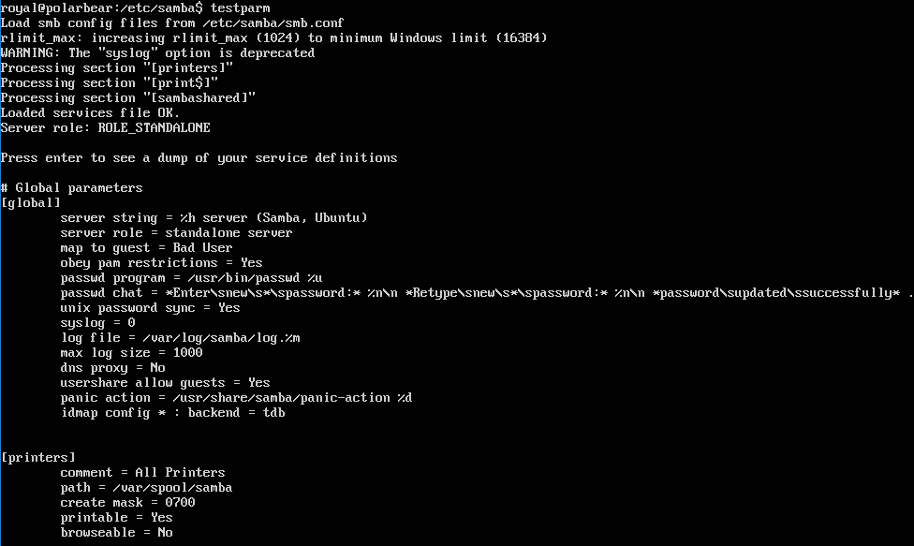
Samba
Run testparm to check for any syntax error in smb.conf

Slide 10
Samba
Once configuration is done, start or restart the samba service
To start samba: sudo systemctl start smbd
To restart samba: sudo systemctl restart smbd

Slide 11
Samba
Samba is not using system password for authentication, we need to setup samba for a user before the user can access to samba server:
sudo smbpasswd -a user_name

Slide 12
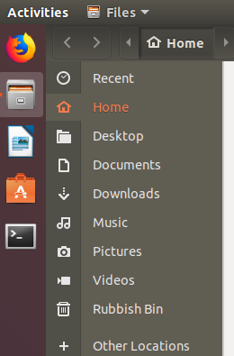
Samba
Connect to Samba server from Ubuntu Desktop
Launch the file explorer
Click on Other Locations

Slide 13
Samba
Connect to Samba server from Ubuntu Desktop
The connection setting is located at the bottom of the window
Enter the server address, with the smb protocol
It can be IP address or domain name

Slide 14
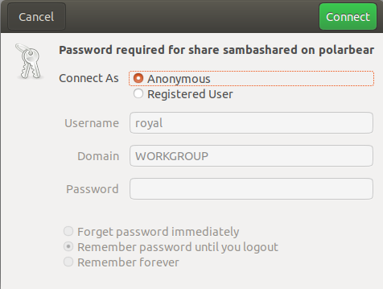
Samba
Click Connect and it will prompt for user name and password (password that set with smbpasswd)

Slide 15
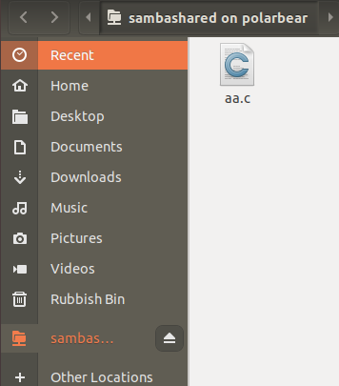
Samba
Once connected successfully, the contents of the shared folder will be displayed in the file explorer.
Click to disconnect

Slide 16
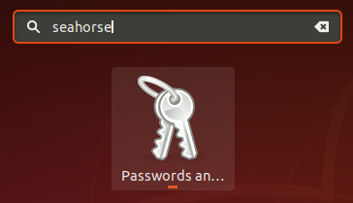

Samba
In case the password has been saved, the connection to samba server will be always using the same user name and password.
The remove the saved password, launch the Password and Key application by searching “seahorse” or “password” in the application.
Click this icon (at the dock bottom) to search

Slide 17
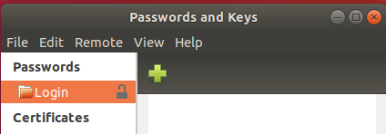
Samba
Right-click on Login under Password and choose Change Password.
Enter the old password and then leave the new password empty.
Once changed, logout or reboot.

Slide 18
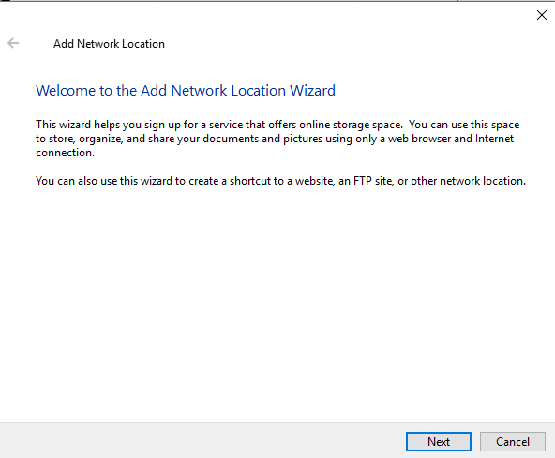

Samba
Connect from Windows 10.
Open File Explorer and click on the Add a network location button to start the wizard.
Click Next.

Slide 19
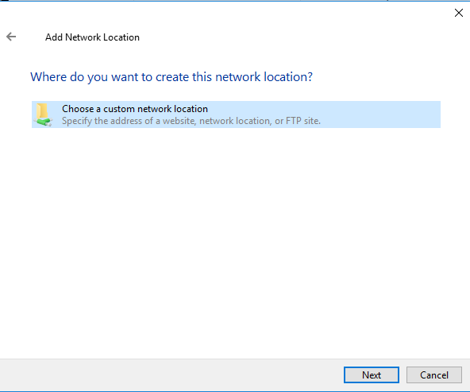
Samba
Connect from Windows 10.
Click Next again.

Slide 20
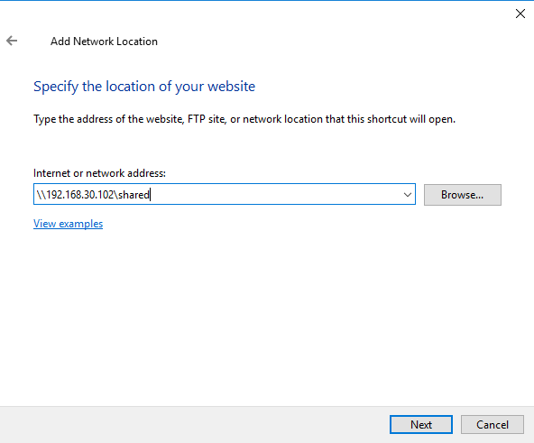
Samba
Connect from Windows 10.
Enter the IP address.
Click Next.

Slide 21
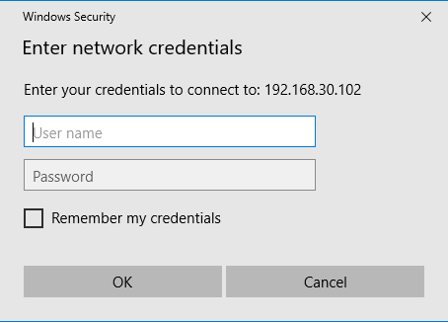
Samba
Connect from Windows 10.
If the IP address is correct, it will prompt for user name and password (set with smbpasswd).

Slide 22
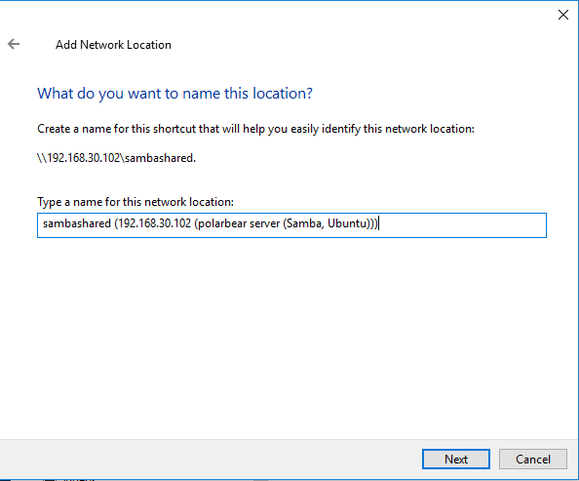
Samba
Connect from Windows 10.
Once connected, the shared folder name and server description will be displayed.
Click Next.

Slide 23
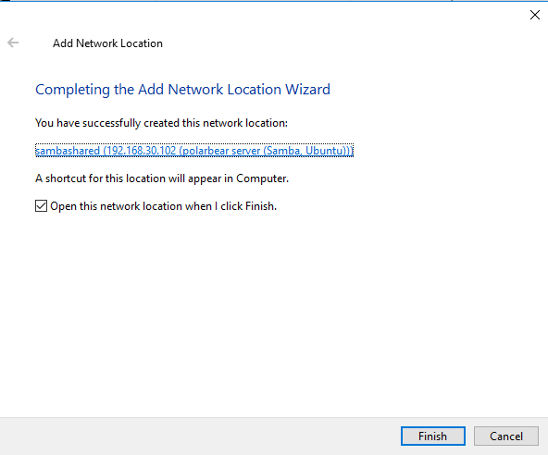
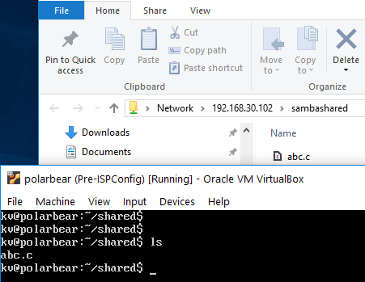
Samba
Connect from Windows 10.
Click Finish to end the wizard and start browsing the folder.

Slide 24
NFS
Best for sharing files from a Linux / UNIX server to a Linux / UNIX server.
To install nfs server:
sudo apt install nfs-kernel-server
NFS will read share information from /etc/exports, which has not been configured.
It’s a good practice to back up it before modification.
sudo cp /etc/exports /etc/exports.ori

Slide 25
NFS
Create a directory for sharing, although it’s not required. Example, /var/nfs
Each share is known as Export.
All exports must be configured in the configuration file /etc/exports

Slide 26
NFS
Sample /etc/exports
/var/nfs * (ro,fsid=0)
/var/nfs/backup 192.168.30.0/255.255.255.0 (rw,no_subtree_check)
/var/nfs/projects 192.168.30.0/24 (rw,no_subtree_check)

Slide 27
NFS
The first line, /var/nfs *(ro,fsid=0,no_subtree_check), is the export root, which will set the base directory for NFS exports.
It is set to read-only (ro) to prevent anyone making changes to the directory
The permission of subdirectory will override the read-only setting.
With export root, we don’t have to specify the full path of export to mount it, we need only the directory name.

Slide 28
NFS
Each of the next 2 lines specifies which directory is being shared and which network is able to access it.
/var/nfs/backup 192.168.30.0/255.255.255.0(rw,no_subtree_check)
/var/nfs/projects 192.168.30.0/24(rw,no_subtree_check)
no_subtree_check disable to subtree checking which had caused stability issues in the past. Disable it will increase the reliability.

Slide 29
NFS
There is another configuration file that we need to edit, /etc/idmapd.conf
Uncomment the line #Domain = localdomain, Change the domain to match the domain used within the network.
This file must be configured the same way in all nodes that connect to the server.
This file is necessary for mapping permission between nodes (same user might have different UID is different nodes, NFS uses UID to reference permission).

Slide 30
NFS
Once configuration is done, restart the NFS service.
sudo systemctl restart nfs-kernel-server
We can add in new export at anytime.
After the changes, we need to make NFS re-read the /etc/exports without disrupting existing connections.
sudo exportfs -a

Slide 31
NFS
Connect to nfs:
Create a mount point. Example: sudo mkdir /mnt/nfsbackup
Use the mount command:
sudo mount server_name:/dir_name mount_point
server_name can be replaced by server’s IP
Example: sudo mount 192.168.30.102:/backup /mnt/nfsbackup

Slide 32
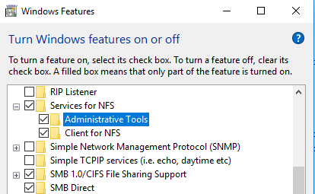
NFS
Connect to nfs from Windows 10:
Make sure that NFS is supported and NFS client is enabled.

Slide 33
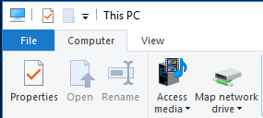
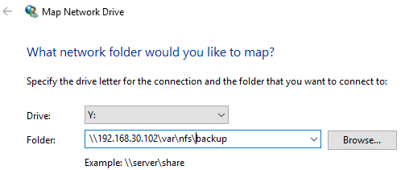
NFS
Connect to nfs from Windows 10:
In File Explorer, click Map network drive
Enter the correct path for the nfs shared folder

Slide 34
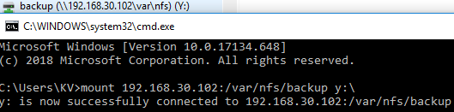
NFS
Connect to nfs from Windows 10:
Enter the user name and password when prompted.
It can be connected using the mount command as well
mount 192.168.30.102:/var/nfs/backup y:\

Slide 35


